Slide 1
Overview of ASP.NET MVC

Slide 2
Contents
Introduction to ASP.NET MVC
Understanding controllers
Understanding views
Demos folder:
Demos-14-MVC

Slide 3
1. Introduction to ASP.NET MVC
What is ASP.NET MVC?
ASP.NET MVC architecture
Creating a new project
Aside - view engines
Project folder structure
Running the starter application

Slide 4
What is ASP.NET MVC?
ASP.NET MVC is a web development platform from Microsoft
A significant evolution for web developers using the Microsoft platform
ASP.NET MVC emphasises the best of the ASP.NET platform and agile development:
Clean architecture
Design patterns
Testability
ASP.NET MVC 6 introduces many new features, including:
Deployment on multiple platforms
Integration with common tools, e.g. Gulp, Bower, Node.js

Slide 5
ASP.NET MVC Architecture
The controller is probably the most interesting player
Processes user input
Works with the model to handle the request
Manages application logic
E.g. navigating a multi-step process, authentication, etc.
Prepares the data to be displayed
This is known as "view data" in ASP.NET MVC
HTTP Request
Controller
Model
View
Response
HTML
View data

Slide 6
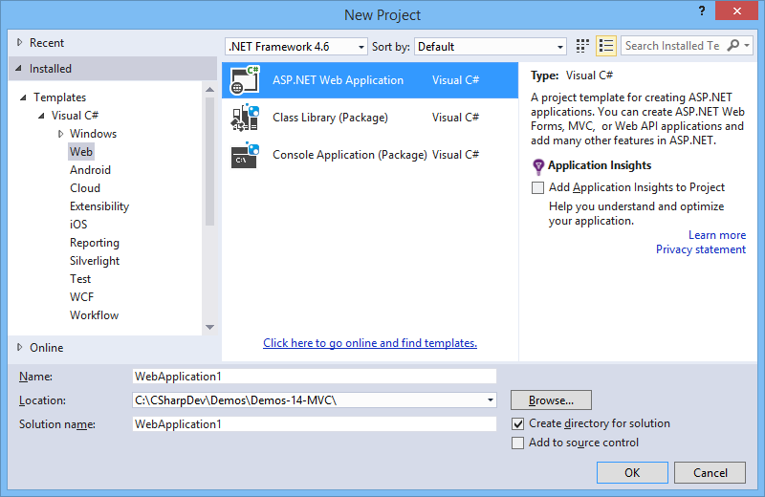
Creating a New Project (1 of 2)
Use the VS 2015 wizard to generate an ASP.NET web app

Slide 7
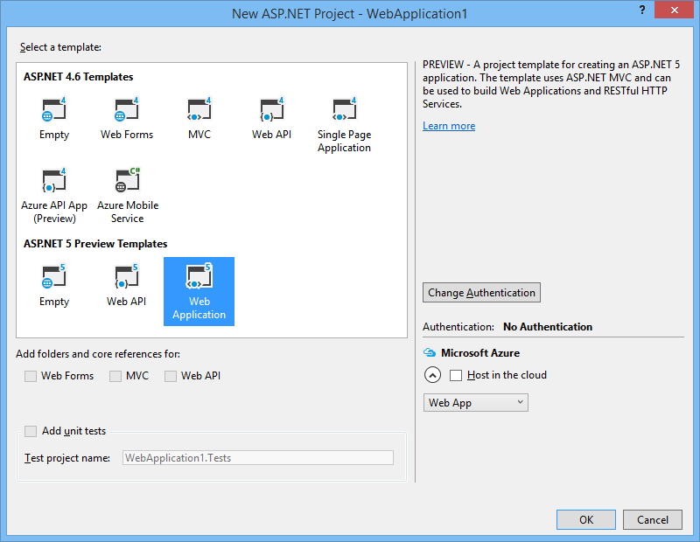
Creating a New Project (2 of 2)
ASP.NET 5 is the current version, and offers 3 templates:
Empty Web project
Web API project, i.e. RESTful Web service
Web Application project

Slide 8
Aside - View Engines
ASP.NET MVC 2 always uses ASP.NET as it's view engine
i.e. when you add a View to a project, you get an ASP.NET View
ASP.NET MVC 3 onwards uses Razor instead
More fluent and intuitive syntax
Easy-on-the-eye combination of HTML and C# (see later)

Slide 9
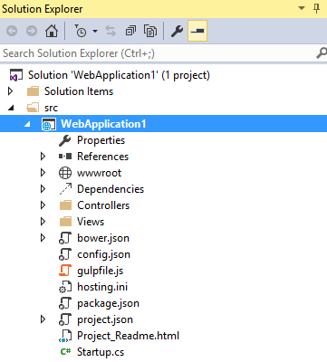
Project Folder Structure
Controller classes
View pages
Performs application start-up tasks

Slide 10
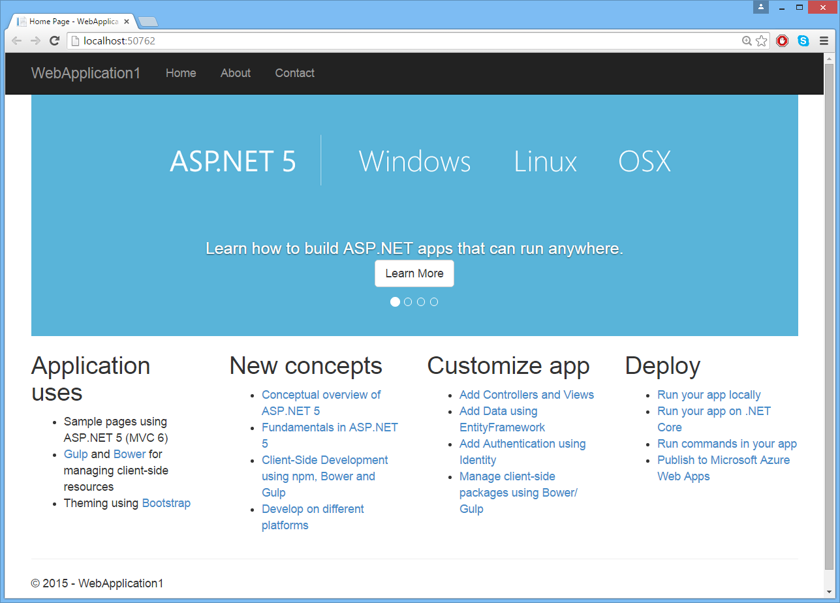
Running the Starter Application
You can run the application as it stands…

Slide 11
2. Understanding Controllers
What is a controller?
Actions
Reviewing the "Home" controller
Routing
Adding new controllers

Slide 12
What is a Controller?
In model-view-controller (MVC) architecture, a controller…
Handles incoming requests
Performs operations on the model
Chooses a view to render back to the user
Controllers are simple C# classes
Inherit from Microsoft.AspNet.Mvc.Controller
Located in the Controllers folder

Slide 13
Actions
Each public method in a controller is known as an "action"
Each action is automatically associated with a URL
Each action performs some operations, and renders back a view
Action methods are easily unit-testable
General syntax:
public class SomeController : Controller
{
public IActionResult SomeActionMethod()
{
// Do some work to prepare data for display.
// …
// Invoke a view, to render HTML (or data, in the case of REST services).
// …
}
…
}

Slide 14
Reviewing the "Home" Controller
VS generated HomeController to get you started
public class HomeController : Controller
{
public IActionResult Index()
{
return View();
}
public IActionResult About()
{
ViewData["Message"] = "Your application description page.";
return View();
}
public IActionResult Contact()
{
ViewData["Message"] = "Your contact page.";
return View();
}
public IActionResult Error()
{
return View("~/Views/Shared/Error.cshtml");
}
}
/Controllers/HomeController.cs

Slide 15
Routing
ASP.NET MVC uses "routing" internally
Decides how to map URLs map to controllers and actions
Startup.cs defines a default routing configuration
Maps any of the following URL patterns to the Index() method on HomeController
i.e. when a browser requests any of these URLs, it gets back the output from the Index() method in HomeController
/Home/Index
/Home
/

Slide 16
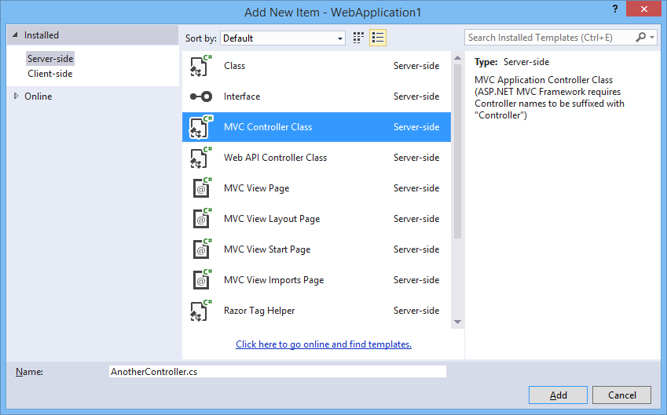
Adding New Controllers
You can add new controllers (to the Controllers folder)

Slide 17
3. Understanding Views
What is a view?
Rendering a view
Implementing a view
Triggering a view
Adding new views

Slide 18
What is a View?
In model-view-controller (MVC) architecture, a view…
Renders model objects, typically as HTML
Can also incorporate client-side intelligence (e.g. Ajax, Angular)
Contains no business logic
Is stateless
ASP.NET MVC 3 onwards allows several view engines
We'll use Razor, because it's more fluent and widely used
You might encounter ASPX in older systems

Slide 19
Rendering a View
Most of our actions render the default view for that action
Except Error(), which renders a specific error view
public class HomeController : Controller
{
public IActionResult Index()
{
return View();
}
public IActionResult About()
{
ViewData["Message"] = "Your application description page.";
return View();
}
public IActionResult Contact()
{
ViewData["Message"] = "Your contact page.";
return View();
}
public IActionResult Error()
{
return View("~/Views/Shared/Error.cshtml");
}
}
/Controllers/HomeController.cs

Slide 20
Implementing a View
Let's take a look at a simple view, for the About() action in HomeController
The view is located in the folder /Views/Home
File name is About.cshtml
.cshtml files use Razor syntax, a mix of C# and HTML
Mostly HTML mark-up, with nuggets of C# code prefixed by @
@{
ViewData["Title"] = "About";
}
<h2>@ViewData["Title"].</h2>
<h3>@ViewData["Message"]</h3>
<p>Use this area to provide additional information.</p>
/Views/Home/About.cshtml

Slide 21
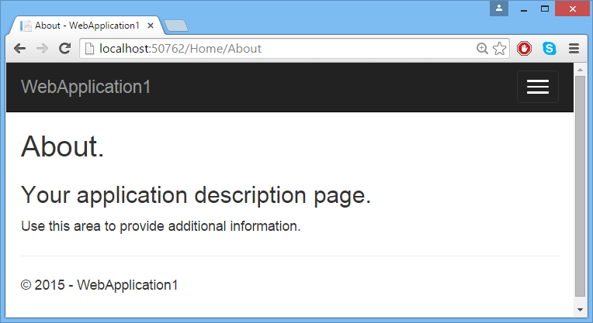
Triggering a View
Run the application and navigate to a URL such as:
http://localhost:50762/Home/About
This part of the page is from About.cshtml
The rest of the page is from _Layout.cshtml, which is the layout (master) page for the app

Slide 22
Adding New Views (1 of 2)
You can add new views as follows:
Create a suitable folder to hold all the views for a controller, e.g. /Views/Another will hold views for AnotherController
Add a view file with a suitable folder for an action method, e.g. Index.cshtml would be the default view for Index()
Example, illustrating some more Razor syntax
@{
ViewBag.Title = "Here's some Razor syntax";
}
<h2>@ViewBag.Title</h2>
<ul>
@for (int i = 0; i < 5; i++)
{
<li>Here's item @i</li>
}
</ul>
/Views/Another/Index.cshtml

Slide 23
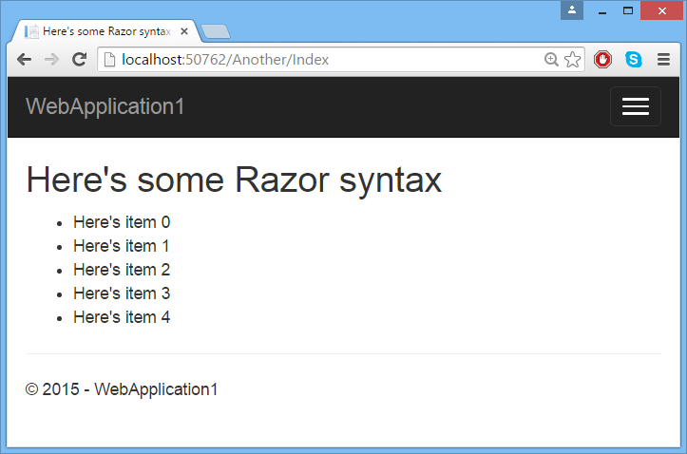
Adding New Views (2 of 2)
Run the application and navigate to a URL such as:
http://localhost:50762/Another/Index

Slide 24
Any Questions?

